Slide 1
SMART SEAT BELT
Under guidance of
Mr/Dr. Faculty,
Designation,
BIT,
Sathy.
Student 1 (201EC151-GURUPRASDH M)
Student 2 (201EC198- MATISVAR MV)

Slide 2
Abstract
THIS IS A SMART SEAT BEALT. THIS SMART SEAT BELT

Slide 3
Problem Statement Addressed
YEARLY MANY DEATHS DUE TO CARDIAC WERE WHILE AT TRAVELING ON THE ALONE AND ALSO THERE SOME POSSSIBILITY OF OTHEER ACCIDENTS BY THE PERSON WHO WAS CAUSED IN THAT SITUATION.

Slide 4
Existing Solution to the Problem Addressed
THE FALLOWING DEATHS DUE TO THE CARDIAC ATTACK CAN BE PREVENTED BY HELPING THE PERSON BY IMFORMING TO THE NEAR BY HOSPITAL.

Slide 5
Proposed Solution to the Problem Addressed
SUCH ACCIDENTS CAN BE PREVENTED BY THE SMART SEAT BELTS BY DETECTING THE CARDIAC ATTACK BY THE FOLLOWING SMART SEATBELTS AND CAN BE INFORMED TO THE NEARBY HOSPITALS AND SO THE MANY ACCIDENTS CAN BE PREVENTED BY THE FOLLOWING METHODS. AND THE INFORMATION CAN BE SEND TO THE FOLLOWING MOBILE NUMBERS IN FORM OF NOTTIFICATON AND SO IT CAN BE MORE HELPFUL.

Slide 6
Project Work Plan
The sensor sense the beart beat level and it gives the data to the arduino board it start the following process.

Slide 7
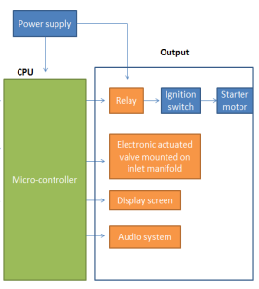
Flow Chart

Slide 8
Effective utilization of the Modern Tool & Cloud
The arduino board acts as a companion or medium between the heart beat sensor and cloud

Slide 9
Analysis of Results & Discussions
According to our clear analysis the usage of this device is very user friendly and it is completely automated and it will be very useful thing in our feature in safe and secure.

Slide 10
Cost Benefit Analysis (List of Components / Service Used)
(Budget)
S.No | Component Name | Specification (IC number or Range or Value) | Unit Cost | Total Cost
1. | Heart beat analysing sensor (The Flexmonitor) |  | 3000 | 3000

